Slide 1


“TeraOpenScience”
Unlocking the Future of Innovation
May 2025

Slide 2

Unlocking the Future of Innovation
TeraOpenScience (TOS-WW)
Our Mission
Foster the Next Generation of High potential Technical And Business Leaders
Become the World’s Premier Virtual Open Science Think Tank

Slide 3

Unlocking the Future of Innovation
TeraOpenScience (TOS-WW)
An AI Enhanced Blockchain Platform
What is TeraOpenScience?
TeraOpenScience is an initiative that fosters collaboration between students, researchers, and business leaders.
We aim to drive innovation through open multidisciplinary teamwork to achieve practical solutions
We will deliver ready-to-launch business plans
We will be self supportive in Year 2

Slide 4


Unlocking the Future of Innovation
TeraOpenScience…
…How it Works
Networking Opportunities
Virtual R&D Projects
Earn ScienceCoins
TeraOpenScience connects students and recent graduates with researchers & industry leaders
Participants can demonstrate their skills to attract hiring managers and companies can showcase their attractiveness to potential new hires.
The platform facilitates collaboration among multi-functional global virtual teams
The teams develop innovative solutions and business plans in a secure environment
Participants earn ScienceCoins through their engagement on the platform.
These coins can be traded on an exchange for various benefits.

Slide 5

Unlocking the Future of Innovation
6
Benefits for Students and Recent Graduates
Free Enrollment
Showcase Work
Network Opportunities
Collaborative Projects
Earn ScienceCoins
Registration for students and young graduates is free of charge
Easy access to the platform and its resources
Students can present their projects and CVs
This visibility helps them stand out to potential employers
The platform connects students with industry leaders
Students gain valuable insights from experienced professionals
Students participate on multidisciplinary teams to work on innovative solutions
Develop skills that prepare them for real-world challenges
Participants can earn ScienceCoins through their engagement on the platform
These coins can be traded, providing additional value for their contributions
Worldwide Open Access to Research

Slide 6
Unlocking the Future of Innovation
8
Benefits for Businesses
Monetization Strategies
Talent Acquisition
Effective Project Management
Innovation Challenges
Fostering Collaboration
Companies can monetize dormant intellectual property through virtual R&D projects
This approach facilitates successful commercialization of innovative ideas
TOS-WW connects businesses with talented students and recent graduates
This platform provides access to fresh perspectives and innovative ideas
Designated team leaders guide projects to ensure alignment with business goals
Effective leadership is crucial for maintaining team motivation and focus
Businesses can tackle pressing innovation challenges by collaborating with multidisciplinary teams and accessing talent outside of the company
Fosters a collaborative environment that enhances creativity and innovation
Companies benefit from the collective brainstorming and problem-solving capabilities of an expanded team
Worldwide Talent Pool

Slide 7

Unlocking the Future of Innovation:
8
Multidisciplinary Teams and…
…delivering Moonshots
Commercialization Pathways
Practical Solutions
Strategies for successful implementation and launch are created
Teams develop solutions and actionable plans for real-world use
Team Formation
Field Testing
Multidisciplinary teams address ambitious challenges
Field testing ensures the practicality of proposed solutions

Slide 8

Unlocking the Future of Innovation
26
Revenue Model of TeraOpenScience
5
Exit Fee
A 10% fee is charged based on the discounted NPV of projects upon exit
4
Project Startup Fee
A startup fee of between $1,000 and $10,000 (Function of the size of the company) is required to initiate a project
3
Project Monthly Fee
There is a monthly cost of $2,000 per student involved in the project, shared with the student
2
Professional Engagements
A subscription fee of $1,000 per year is charged for access to commercial services
1
Students Sign-Up
Students' sign-ups are offered free of charge.
Driving sign-ups though extensive social media influencers activity

Slide 9
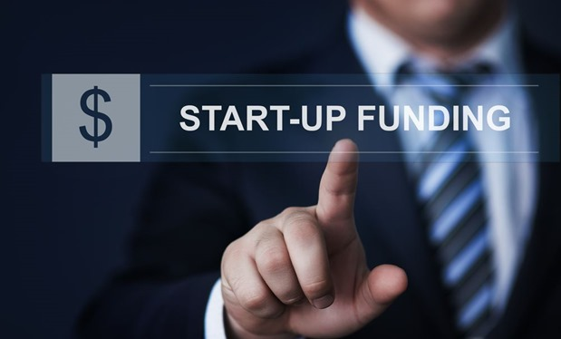

Unlocking the Future of Innovation
Initial Funding and Exit Strategy
Funding Requirements
Funding Utilization
We require initial capital of $2 million for the platform’s re-launch.
TeraOpenScience should be self-supportive as of Year 2
IT Platform upgrade (300K)
Headcount ($200K)
Marketing communication ($500K)
Contingency $1,000K)
Projected Valuation
Our exit strategy targets a valuation of $50 million in Year 4 based on a multiple of 4 times projected EBITDA and/or a 20% discounted NPV

Slide 10
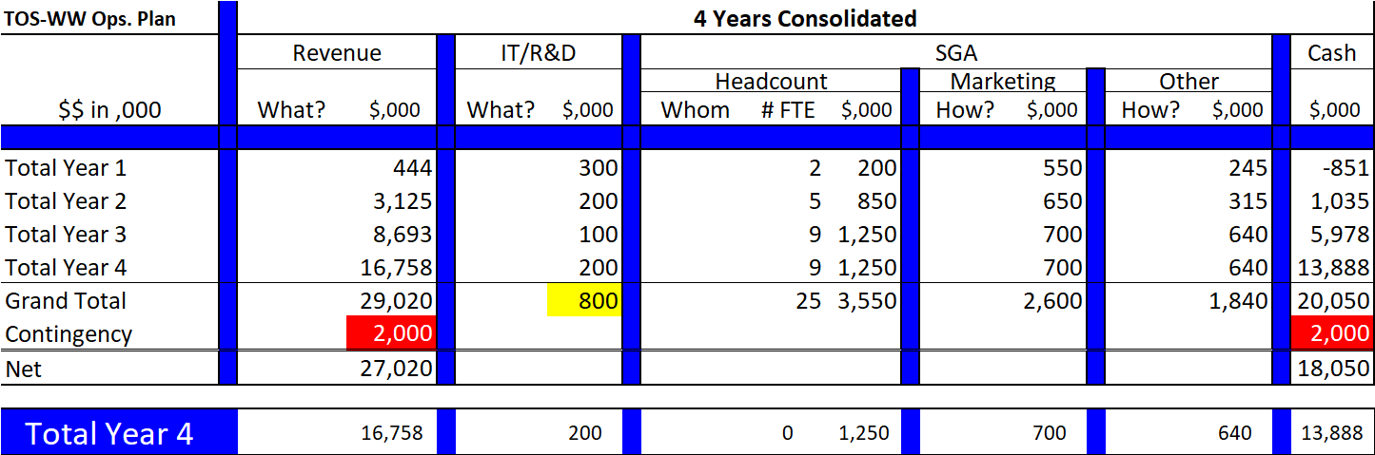
Unlocking the Future of Innovation
29
Summary of Financials

Slide 11
Unlocking the Future of Innovation
29
Summary of TeraOpenScience's Impact
A (Win/Win/Win) x2 Model
Global Collaboration
Talent Development
Innovative Solutions
Connecting students with industry professionals. Bridging the gap between academic knowledge and practical expertise.
Connects Technical and business leaders with global graduate talent to enhance practical skills and career opportunities
Multidisciplinary teams combine diverse expertise to create innovative solutions
Commercialization Opportunities
Performance Metrics
Exit Strategy
Delivering field tested commercialization business plans.
Track growth in student and professional engagement as well number of projects started and closed
The initiative aims for a valuation of $50 million in Year 4 based on projected EBITDA
All Contributors Can Earn ScienceCoins

Slide 12

Unlocking The Future of Innovation
11
Leadership and Operational Execution
Executive Leadership
The leadership team consists of 4 seasoned executives with complimentary and extensive industry experience who are stakeholders in the company.
Leadership, Financial, Technical, Marketing, Commercialization and Operational expertise
They drive TeraOpenScience's mission through strategic decision-making and oversight.
Operational Execution
Leverage the leadership team’s experience from start to finish in innovation and commercialization to build the foundation of the platform.
In Year 1,
We will hire one fulltime young scientist and one full time young marketeer who will bring a fresh perspective and innovative ideas.
We will engage an independent IT consultant.
Engage third party social media Influencers to bring students and professional onto the platform.

Slide 13

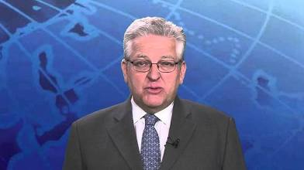
Unlocking The Future of Innovation
11
The Executive Team
COO: Jerome Hamilton
From producing products for General Motors & Ford, to medical device manufacturing, my experience is thorough. Currently a Chief Operating Officer and prolific board member and co-founder of Brown Venture Group. Co-author of the book, “Make Your Business a Lean Business”[ISBN 9781439829998].
CEO: Patrick Deconinck
Experienced and results-oriented Global Business Executive. From Vision to Execution. Customer focus. Proven track record of creating value, even during difficult times, through innovation, M&A and profitable organic growth. Broad experience in Europe, the USA and worldwide. Charismatic leadership style. Empowering, yet holding people accountable.

Slide 14
“TeraOpenScience”
Unlocking the Future of Innovation
Contact us
TeraOpenScience LLC aka TOS-WW
President/CEO: Patrick Deconinck
1213 Tamberwood Trail Woodbury, MN 55125
www.tos-ww.com
Patrick@tos-ww.com
651.253.7873

