Slide 1
Sustainable cleaning products – Situation analysis

Slide 2
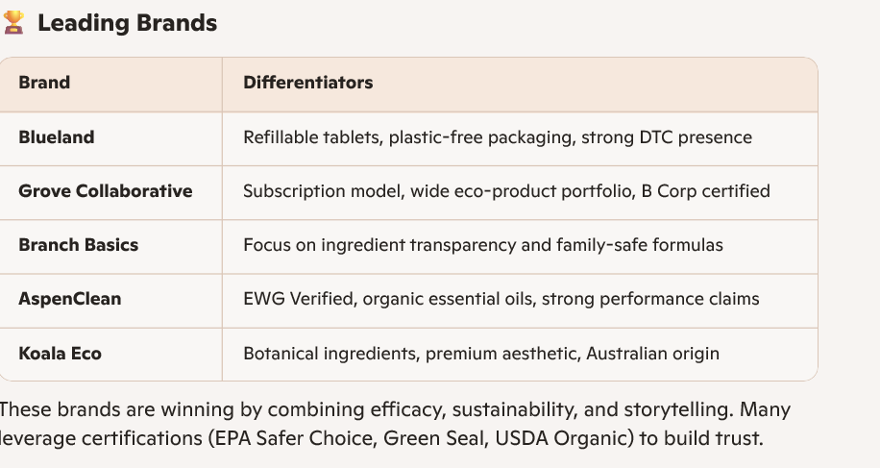
Sustainable cleaning products – Top Brands

Slide 3
Sustainable cleaning products – Market size next 10 years

Slide 4
Sustainable cleaning products – Innovation

Slide 5
Sustainable cleaning products – Financials

