Slide 1
THERAPOID
Client: Open Therapeutics

Slide 2
About THERAPOID
Therapoid is an open science platform that provides students and researchers with free tools, services, intellectual properties.
It also awards ScienceCoins tokens (similar to cryptocurrency) for collaborating and advancing knowledge.

Slide 3
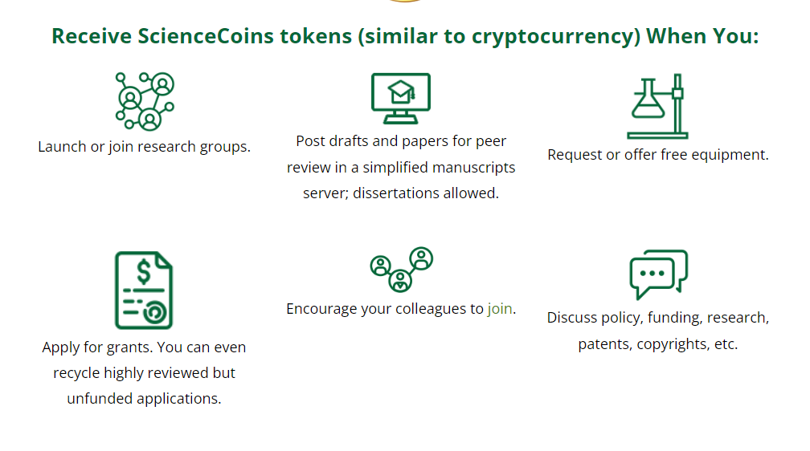

Slide 4
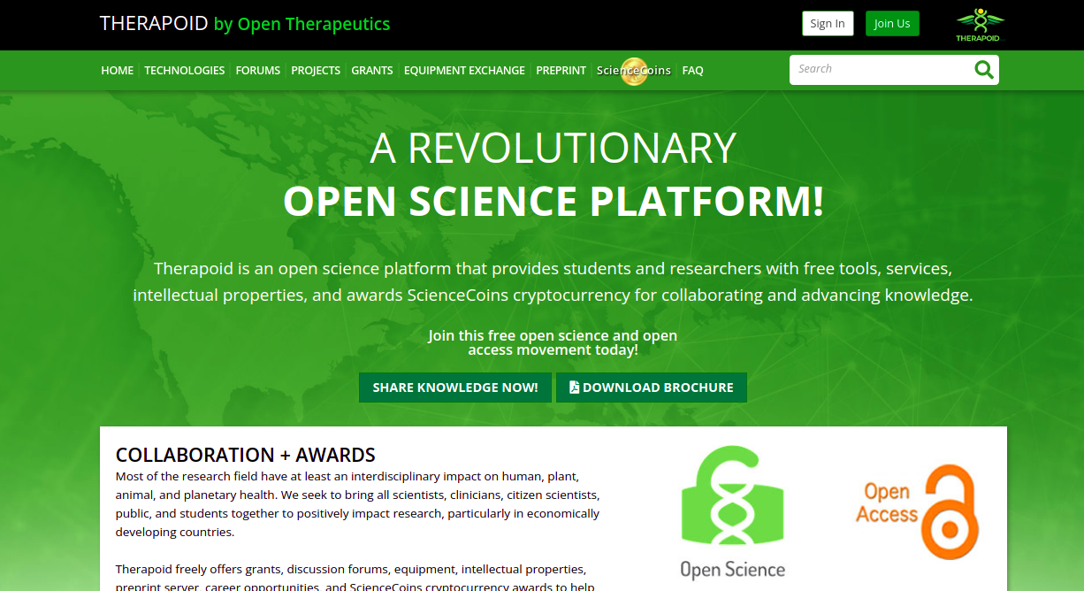

Slide 5
Client Details
Client Name: Jason E. Barkeloo .
Client Location: Cincinnati, Ohio 45230,United States
Stakeholder’s: Open Therapeutics.
Project Name: Therapoid

Slide 6
Team Size & Technology
Total Team size: 12
Project Manager: Sudipta Banerjee
Delivery Head & Scrum Master: Naveen Namperumal
Project Coordinator & BA : Akhil Katta
Developer Lead: VishnuTej, Debasissa Dash
Block chain Developer : Balaji Pachai
Test Engineer: Sagarika Dash, Mahadevswamy ,Mohima
UI/UX Developer: Sanjith
Mobile Developer:Saravanan, Lakshmanan
Technology
1. Django Framework
2. Python
3. Block Chain
4. Postgres
Version Control: GIT Lab
Deployment: CI/CD, AWS pipeline

Slide 7
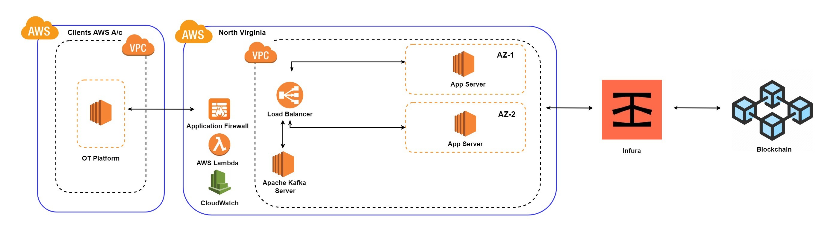
Block Diagram

Slide 8
Nature of Engagement
Tailored SDLC project
Requirement & Analysis: Requirements are provided by Client in the form of enhancements or change requests in Jira.
We maintain two Jiras:
Therapoid Platform – Clients provide requirements and report issues
Therapoid.net - We take up the requirements and reported issues from Therapoid platform and plan sprints by assigning it to respective team member
2. Design: The approach is planned considering the various feasibility aspects with respect to the current requirements.
3. Implementation: Based on the approach formulated the implementation is performed using the Python Tech stack
4. Testing: Testing and QA activity are performed once the development tasks are completed
5. Deployment: Continuous Integration and Continuous Deployment adopted with AWS pipeline.

Slide 9
Environments
Test server : http://opentherapoid.v2soft.com/
Stage server : https://staging.therapoid.net/
Production server : http://therapoid.net/

Slide 10
IS Requirements of Open Therapoid
1. User access will be based on Role and Feature level Permission
2. Using Google & Microsoft Authenticator for registration and login
3. Based on user activity registered user will be allocated science coins.
4. Utilized frame feature to prevent SQL injection, cross site scripting (XSS)
5. Utilizing the https as protocal in rest call (between blockchain server and therapoid server)
6. Site will be deployed under SSL

Slide 11
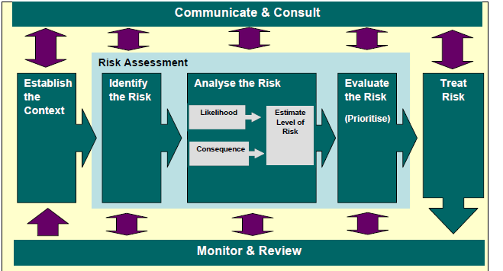
ISO 31000 based- Risk Management

Slide 12
ISO 27001:2013 –Applicable Control
ISMS
A.14.1.1 | Information security requirements analysis and specification
A.14.1.2 | Securing application services on public networks
A.14.1.3 | Protecting application services transactions
A.14.2.1 | Secure development policy
A.14.2.2 | System change control procedures
A.14.2.3 | Technical review of applications after operating platform changes
A.14.2.4 | Restrictions on changes to software packages
A.14.2.5 | Secure system engineering principles
A.14.2.6 | Secure development environment

Slide 13
ISO 27001:2013 –Applicable Control
ISMS
A.14.2.7 | Outsourced development- Excluded
A.14.2.8 | System security testing
A.6.1.5 | Information Security in Project Management

Slide 14
Thank You!

